Slide 1
Metadata
Victoria Worthington, December 2024
Mentor: Kelsey Kyllonen

Slide 2
Understanding the Metadata Challenge
Center of Healthy Communities had a growing collection of project data (metadata)
Needed a way to easily review, analyze, and share this metadata
Goal: Identify a solution that minimized cost and effort while maximizing usability

Slide 3
Exploring Available Options
Traditional databases: robust but costly and complex
Specialized metadata management tools: limited fit for unique needs
Customized solutions: potentially time-consuming and expensive
Need: A lightweight, flexible approach

Slide 4
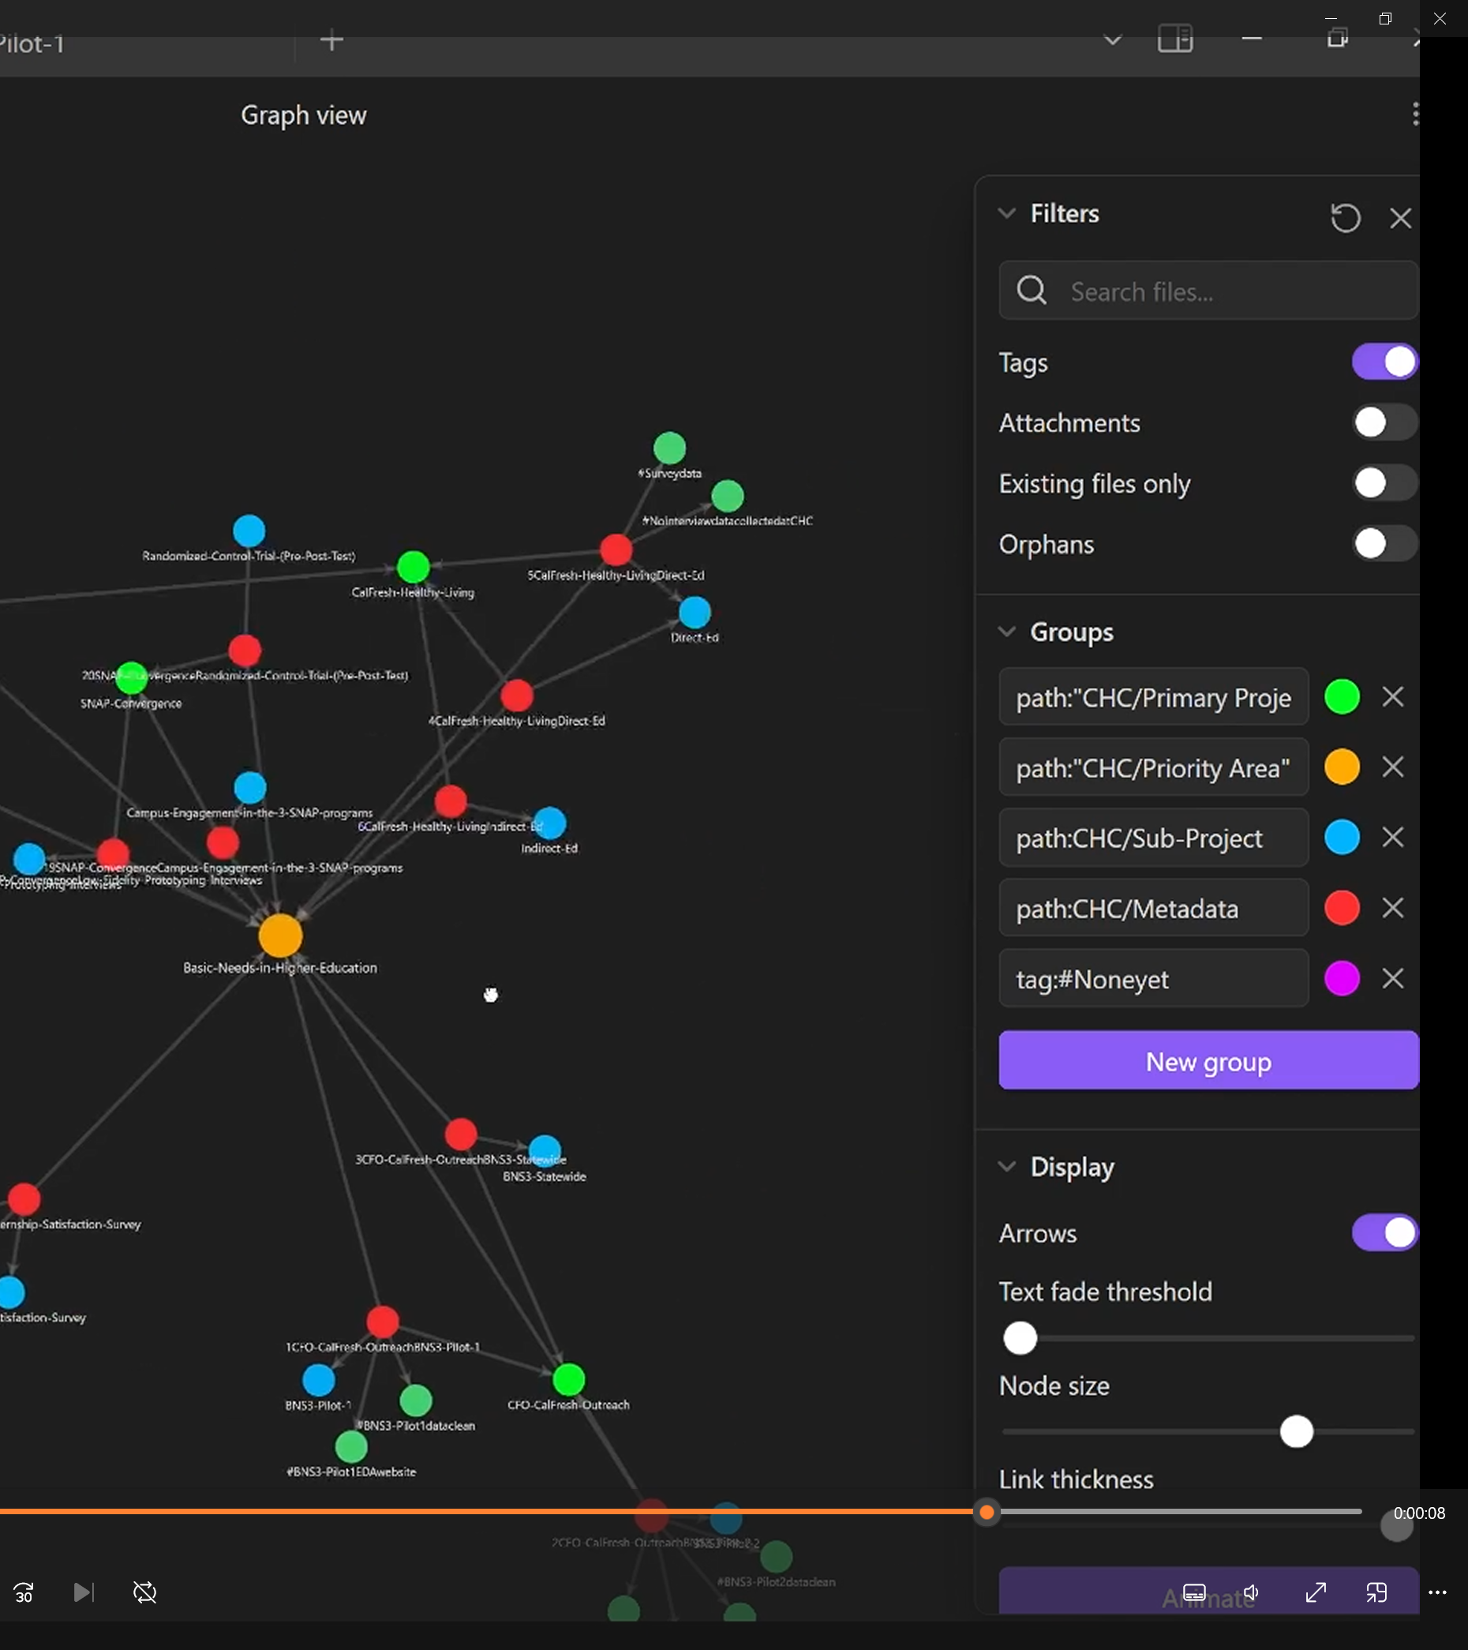
Utilizing a Note-Taking Platform
Chose Obsidian, a versatile note-taking tool
Python script to import and format metadata as individual notes
Utilize tags and Obsidian’s graph view to visualize relationships

Slide 5

Shift in Project Focus
Organizational focus shifted from general project metadata to research citations
Decision: Prioritize organizing and centralizing citations
Zotero selected for citation management

Slide 6
Centralizing Citations in Zotero
Zotero: An open-source, collaborative citation tool
Imported over 300 citations from various spreadsheets
Created a shared library for easy access by team members

Slide 7
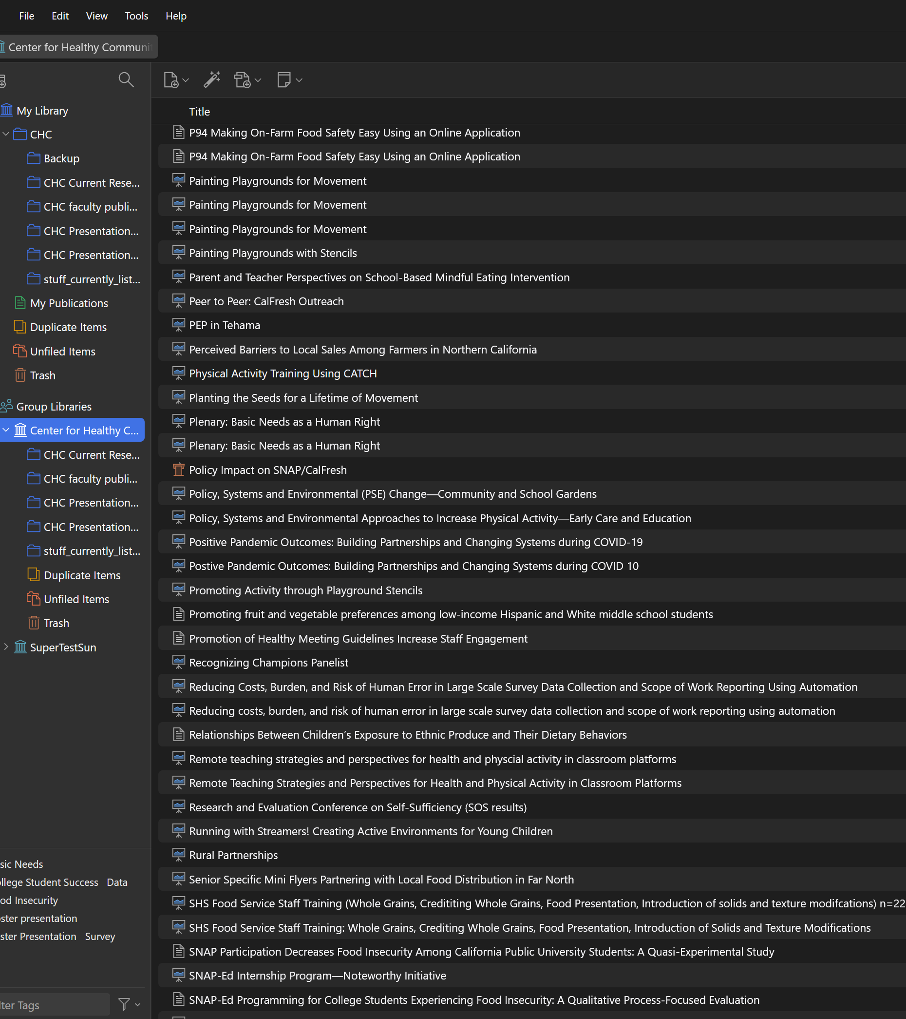
What We Achieved
Unified repository of research citations
Streamlined workflow for referencing materials in grant proposals, articles, and presentations
Reduced time spent searching for past citations

Slide 8

Thank you
Victoria Worthington

